Slide 1
PayPal Merchants and Braintree Merchants – A Tool, Scores and Rules
Dwipam Katariya(Data Science Intern, GRDS)
M.S. Data Science (Indiana University)

Slide 2

What Do I want to Do
Learn
Explore
Impact

Slide 3
Objective 1
Scoring NON-Braintree Merchant for Braintree activation

Slide 4
Why ?

Slide 5
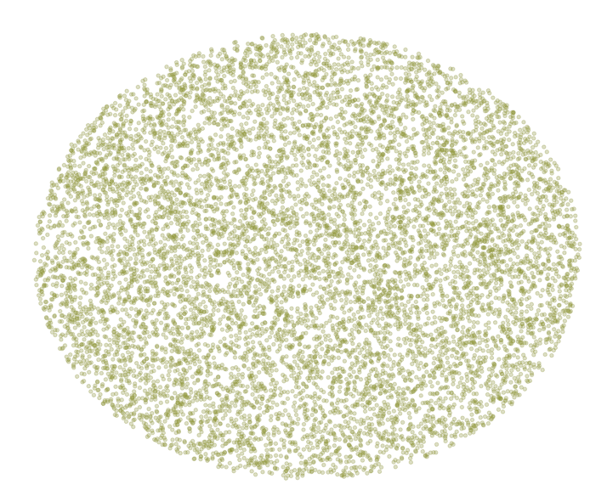
Braintree Merchants
K-means
Braintree Merchants
Group 1
Group 2
Centers

Slide 6
Braintree Merchants
K-means
Group 1
Group 2
Centers

Slide 7
Braintree Merchants
K-means
Group Allocation
Non-Braintree Merchants
Group 1
Group 2
Non Braintree Merchants

Slide 8
Braintree Merchants
K-means
Group Allocation
Likelihood
Label NON-Braintree Merchants
Non-Braintree Merchants
More Likely
Total NON BT merchants more likely to be BT merchant | 37712
Total NON BT merchants Less likely to be BT merchant | 33954
Less Likely
More Likely for Braintree activation are having distance less than the average distance for the respective group
Less Likely for Braintree activation are having distance greater than the average distance for the respective group

Slide 9
What separates Most likely and Less Likely

Slide 10
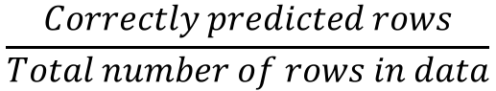
Braintree Merchants
K-means
Group Allocation
Likelihood
Label NON-Braintree Merchants
Decision Tree
Non-Braintree Merchants
SOC = Proportion of Branded TPV to all the TPV
TPV Growth = Total Payment volume growth per quarter
Take Rate = PayPal that charges for each transaction
Decision Tree
Labelled NON-Braintree Merchants
SOC > 0.35 | TPV Growth 0.52 - 1.465 | Take Rate > 0.02 | More likely NON BT Merchant for BT integration
True Positive | 64.9%
True Negative | 21.12%
False Positive | 11.4%
False Negative | 2.5%
Accuracy =
$$\frac{Correctly predicted rows}{Total number of rows in data}$$
Model accuracy 86%

Slide 11
Scoring and grouping
Total NON BT merchants more likely to be BT merchant (Score <= 1.0) | 37712
Total NON BT merchants Less likely to be BT merchant (Score > 1.0) | 33954
Score | Lookalike Strength | Number of Non-BT Merchants
0.464 - 0.649 | High(Top 1%) | 666
0.649-0.827 | Medium(1%-25%) | 16080
0.827-1.00 | Low(25%-53%) | 20966
Score : Distance between the closest center
Average distance for the closest group
Lower the score, higher is the likelihood to be the BT merchant
Non-BT merchants with High category has mostly Express Checkout, NO Mass Payment and No Branded Decline.
Merchants with score greater than 1.00 are less likely merchants.
Top 1% is the 1% quantile of the score.

Slide 12
Variables | High | Lowest | BT Merchants
Median TPV Growth | 1.03 | 1.06 | 1.00
Mean TPV Growth | 1.04 | 1.16 | 1.03
Median Take Rate | 0.030 | 0.021 | 0.029
Mean Take Rate | 0.031 | 0.025 | 0.030
Median product count | 4 | 3 | 4
Median Last 12 months TPV Bin | 250000 | 500000 | 250000

Slide 13
Variables | High(Top 1%) | Lowest 10% | BT Merchants
Median TPV Growth | 1.03 | 1.06 | 1.00
Mean TPV Growth | 1.04 | 1.16 | 1.03
Median Take Rate | 0.030 | 0.025 | 0.029
Mean Take Rate | 0.031 | 0.025 | 0.030
Median product count | 4 | 3 | 4
Median Last 12 months TPV Bin | 250000 | 500000 | 250000

Slide 14
Variables | High(Top 1%) | Lowest 10% | BT Merchants
Median TPV Growth | 1.03 | 1.06 | 1.00
Mean TPV Growth | 1.04 | 1.16 | 1.03
Median Take Rate | 0.030 | 0.025 | 0.029
Mean Take Rate | 0.031 | 0.025 | 0.030
Median product count | 4 | 3 | 4
Median Last 12 months TPV Bin | 250000 | 500000 | 250000

Slide 15
Variables | High(Top 1%) | Lowest 10% | BT Merchants
Median TPV Growth | 1.03 | 1.06 | 1.00
Mean TPV Growth | 1.04 | 1.16 | 1.03
Median Take Rate | 0.030 | 0.025 | 0.029
Mean Take Rate | 0.031 | 0.025 | 0.030
Median product count | 4 | 3 | 4
Median Last 12 months TPV Bin | 250000 | 500000 | 250000

Slide 16
Objective 2
Build a package in R for two type class prediction, score and Identify the rule responsible for the prediction for each row in the data.
Apply tool to the Brain Tree Data having classes as Brain Tree Merchant and Non-Brain Tree Merchant.

Slide 17
Train Data
(Class=0,1)
Test Data
Response Column name
Output processed by Tool
Tool overview
Tool
Compression in %
Input:
Train Data = Already predicted data(Historic Data). With two type of class i.e. 0 or 1.
Response column name = The column of interest that represents prediction.
Test Data = Data to be predicted, scored and rules for prediction to be identified.
Compression = Used to reduce the number of columns used for training.
Output:
Performance: Measure performance in terms of accuracy.
Most important variables: Most important column names responsible for predictions.
ID = The column of ID’s ( Can be Merchant ID, Customer ID etc.) in test data
Score = Probability of the prediction.
Rules = Column names and their values that are Highly responsible for the response for each ID.
Response = The class predicted for each ID ( e.g. 1 if it belongs to class BT Merchant, 0 if it is does not)
For Test Data :
ID
Response
Rules
Score
For Train Data:
Performance
Most Important variables for prediction

Slide 18
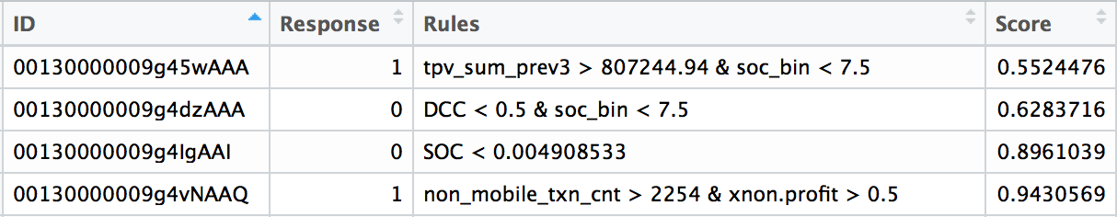
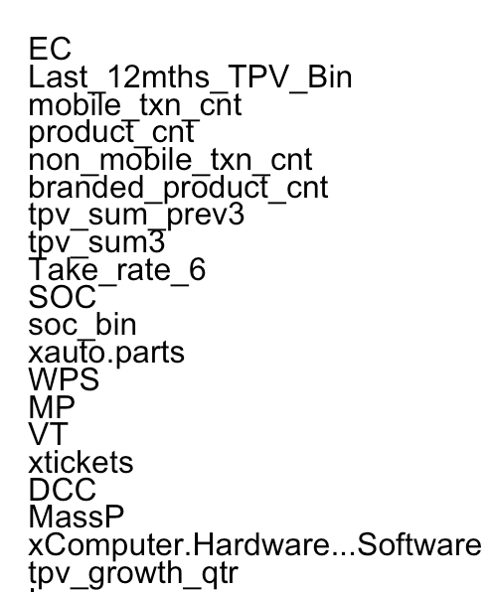
1 | Braintree Merchant
0 | Non-Braintree Merchant
Most Important Variables

Slide 19
©2015 PayPal Inc. Confidential and proprietary.
Challenge
Presentation &
Explanation

Slide 20
More than
Work
INNOVATION
Visited Michael’s Lab of Innovation a tuesday
Opportunity to visit presentations from Research club
WELLNESS
Regular visit to PayPal Recreation center and Loved sometimes playing cricket on Fridays.
The
Culture
We advocate for inclusion in all its forms: global, financial, economic, technological, social and individual
INCLUSION
Always attended Global Team meetups whenever possible
COLLABORATION
Discussed obstacles in the project with the team and received guidance for better solutions.

Slide 21
Work is not Always Work !

Slide 22
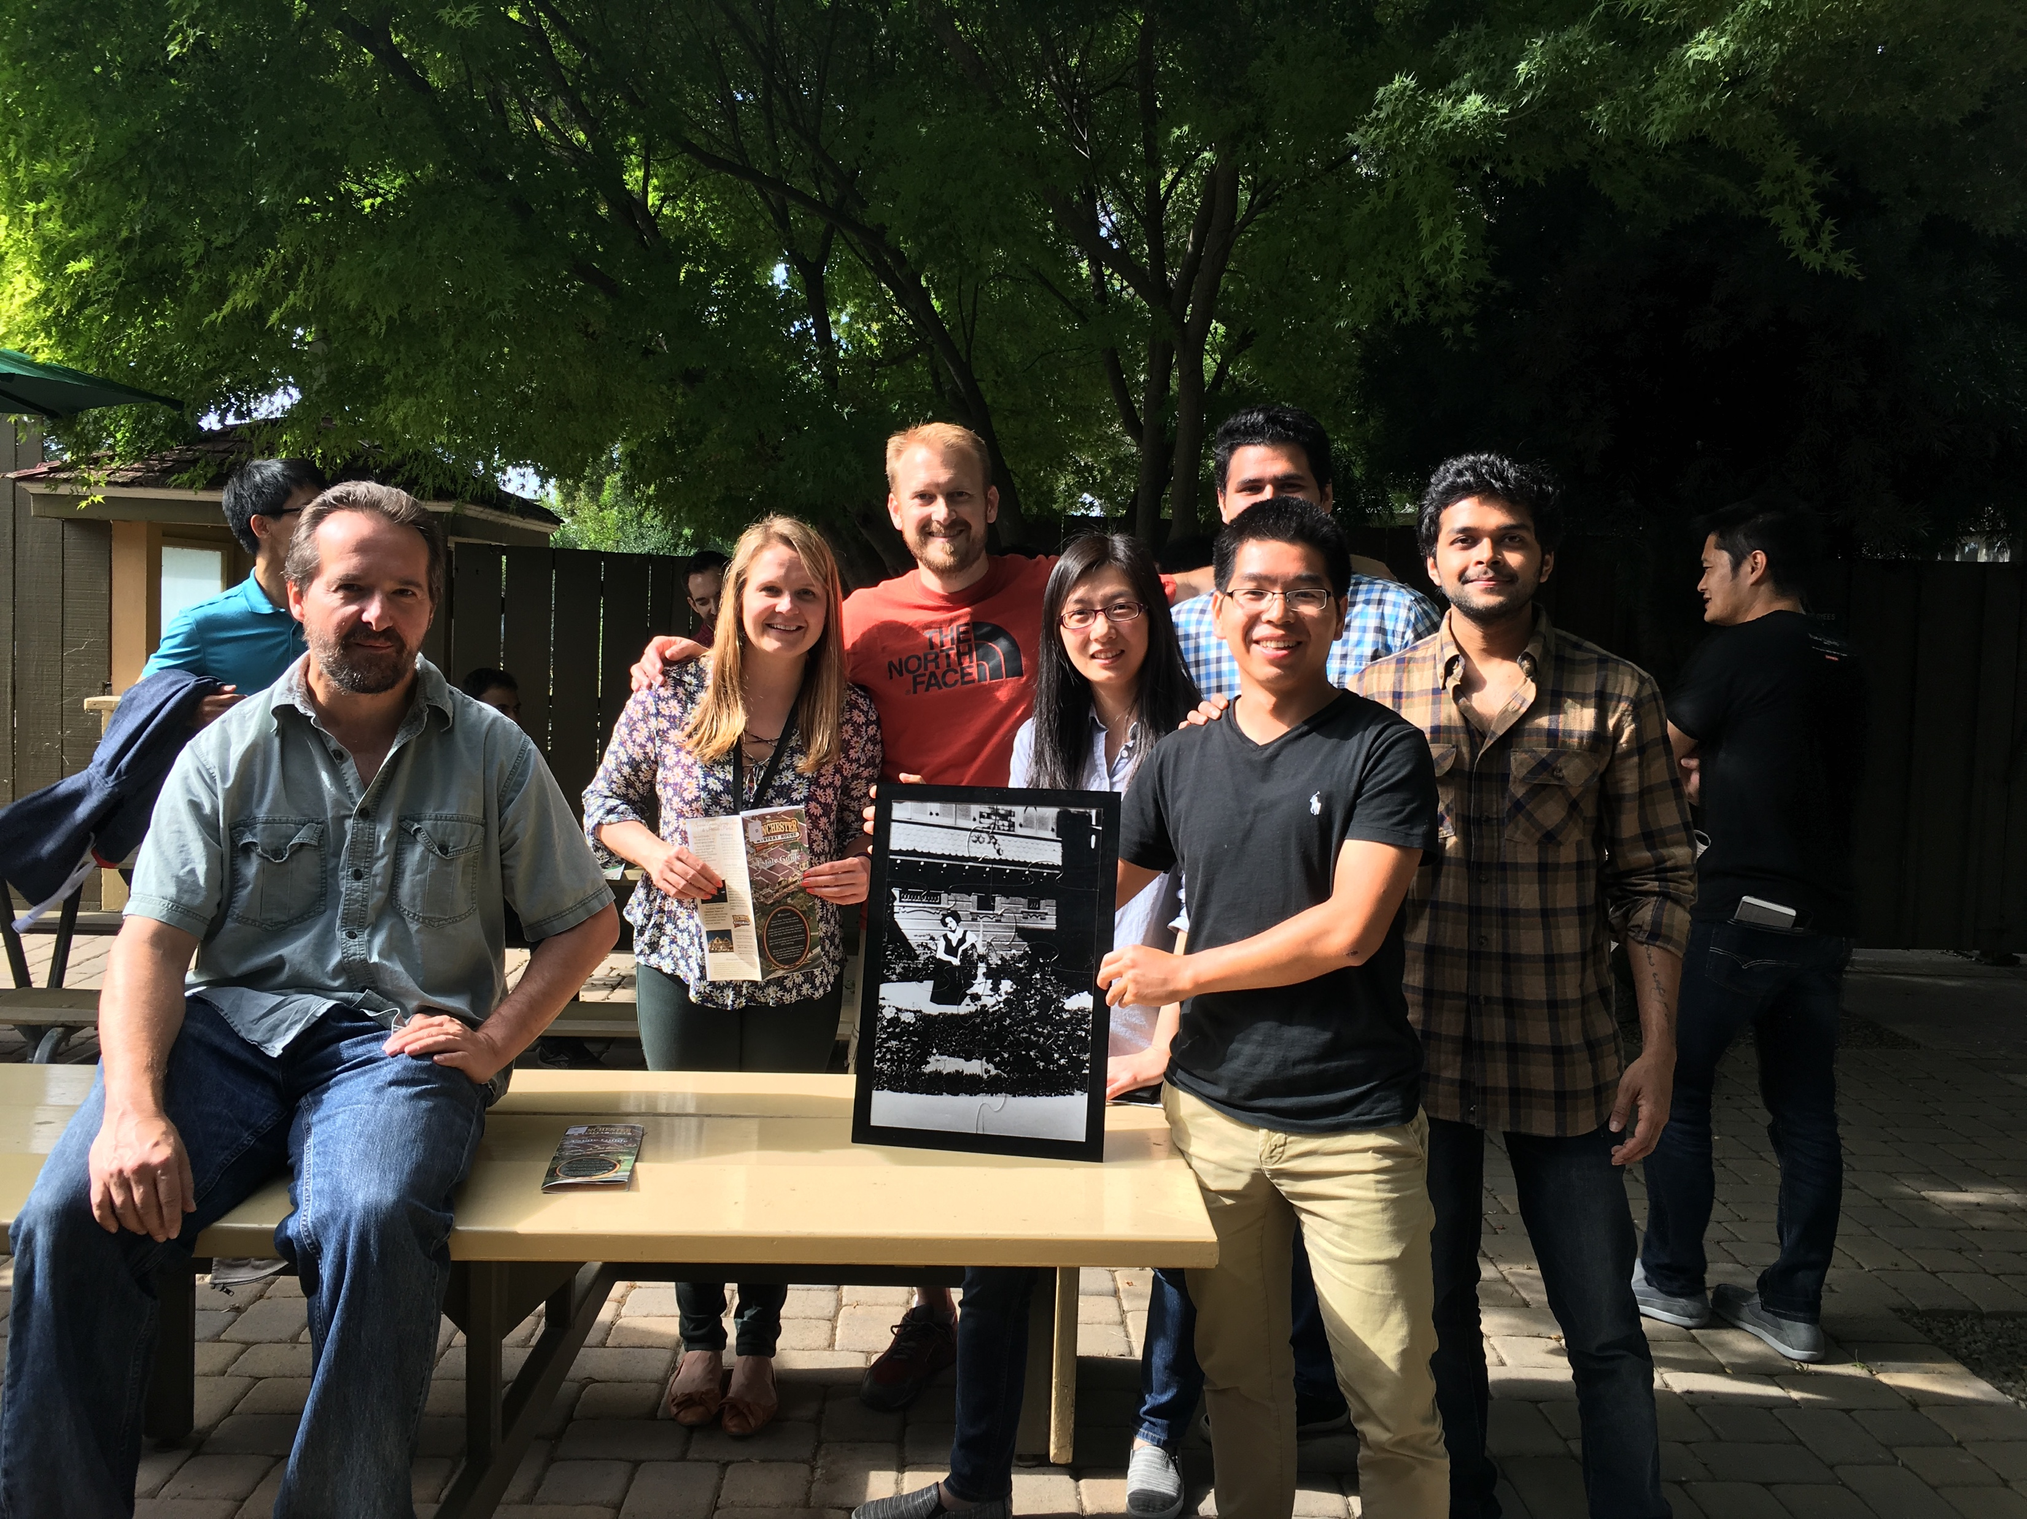
CRM - GRDS Joint Event

Slide 23

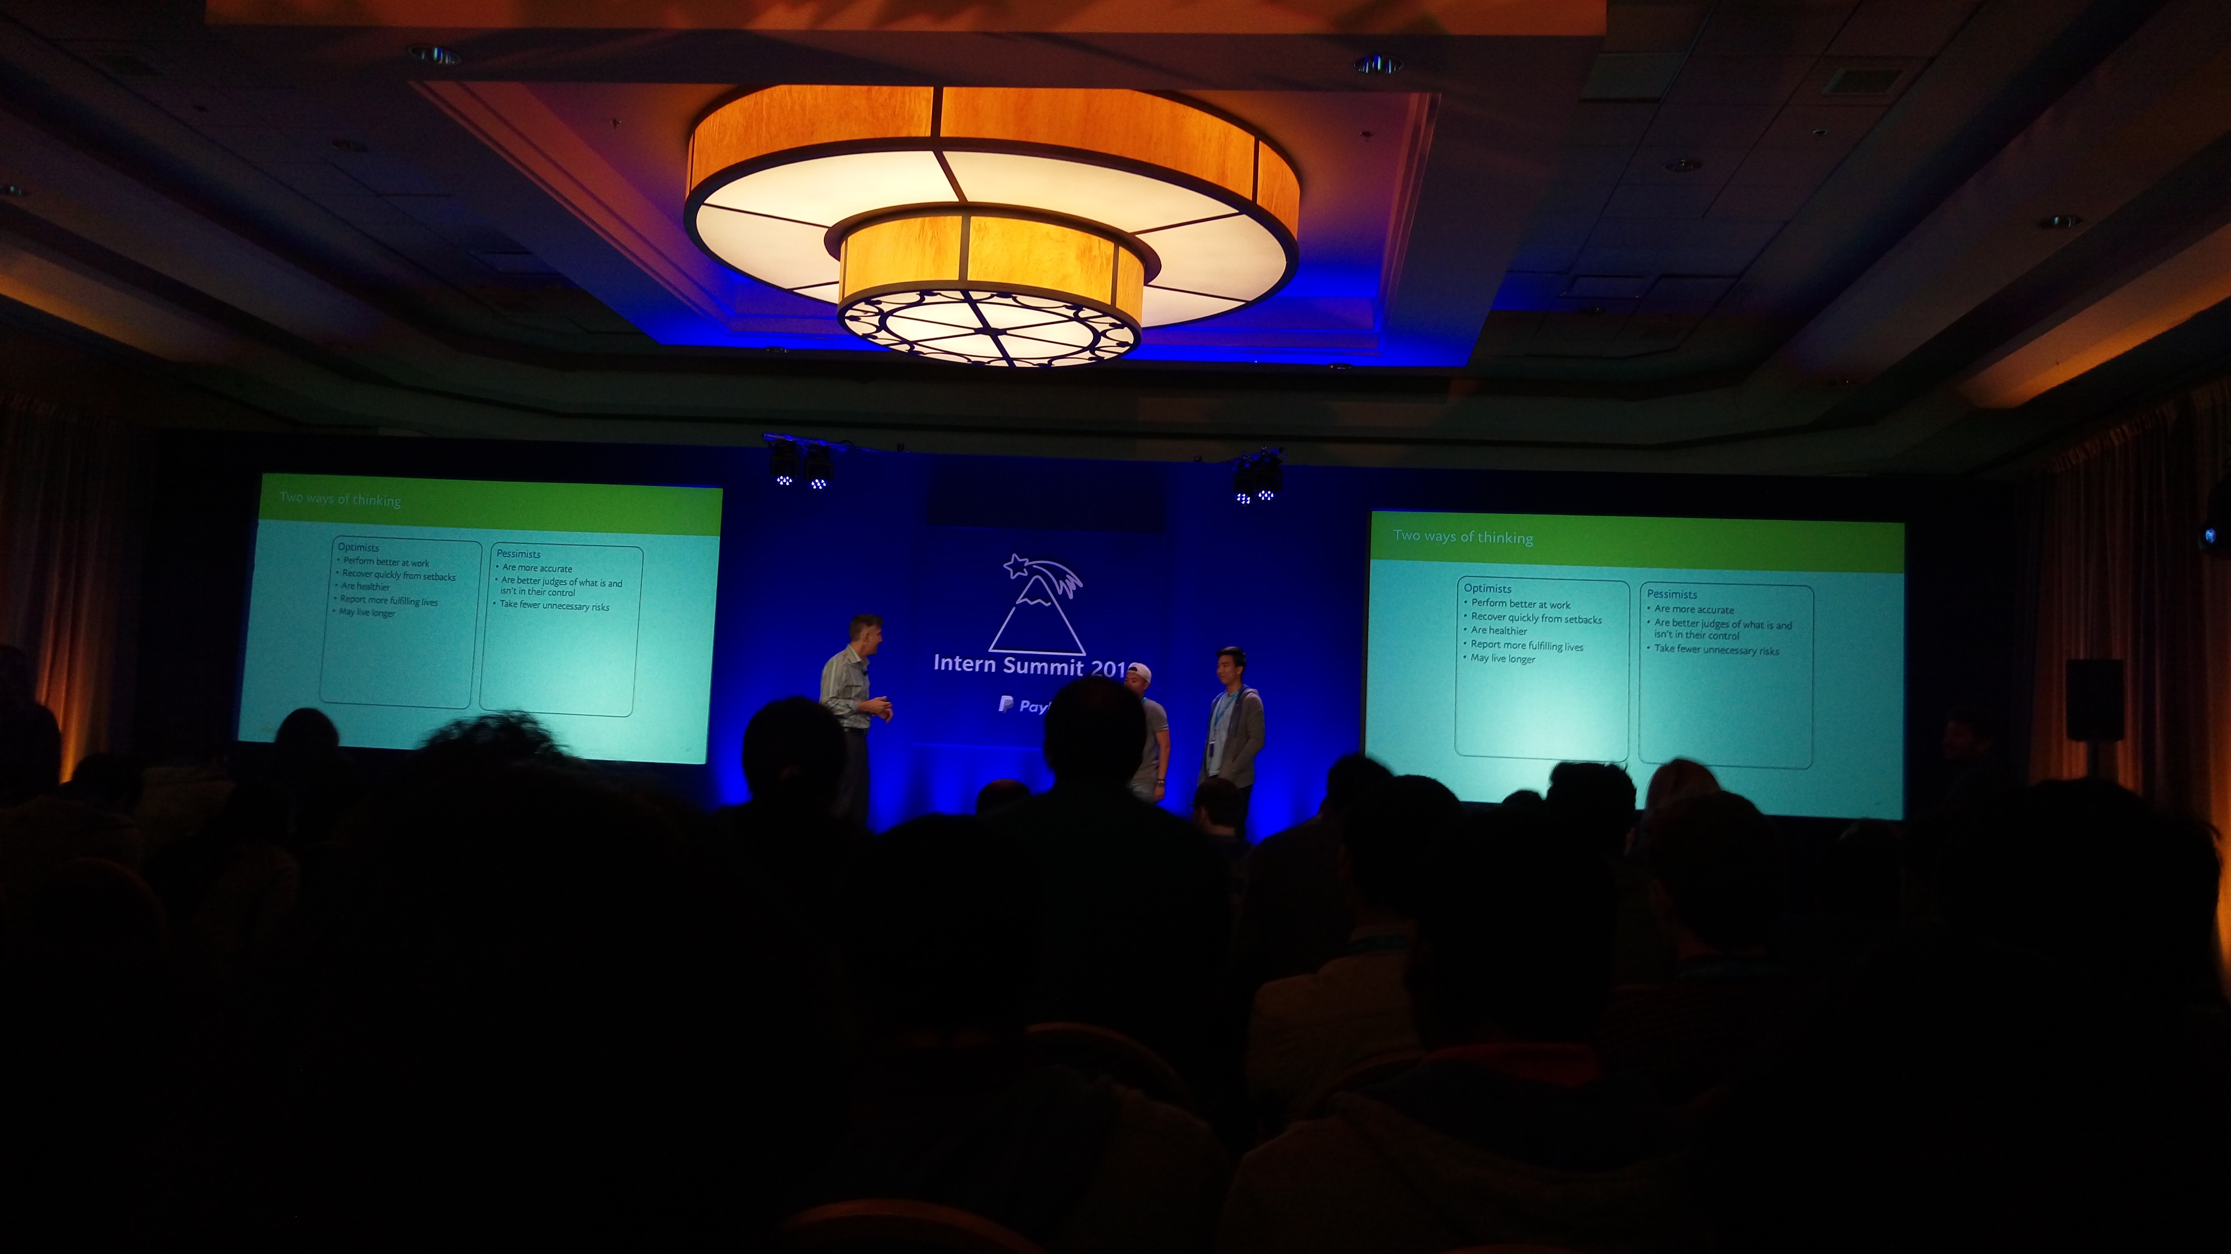
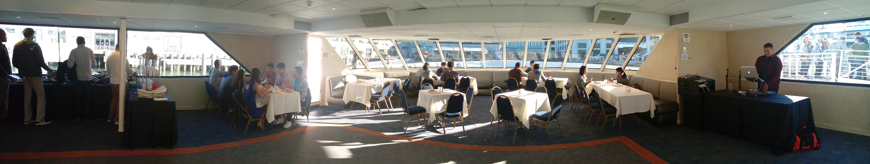
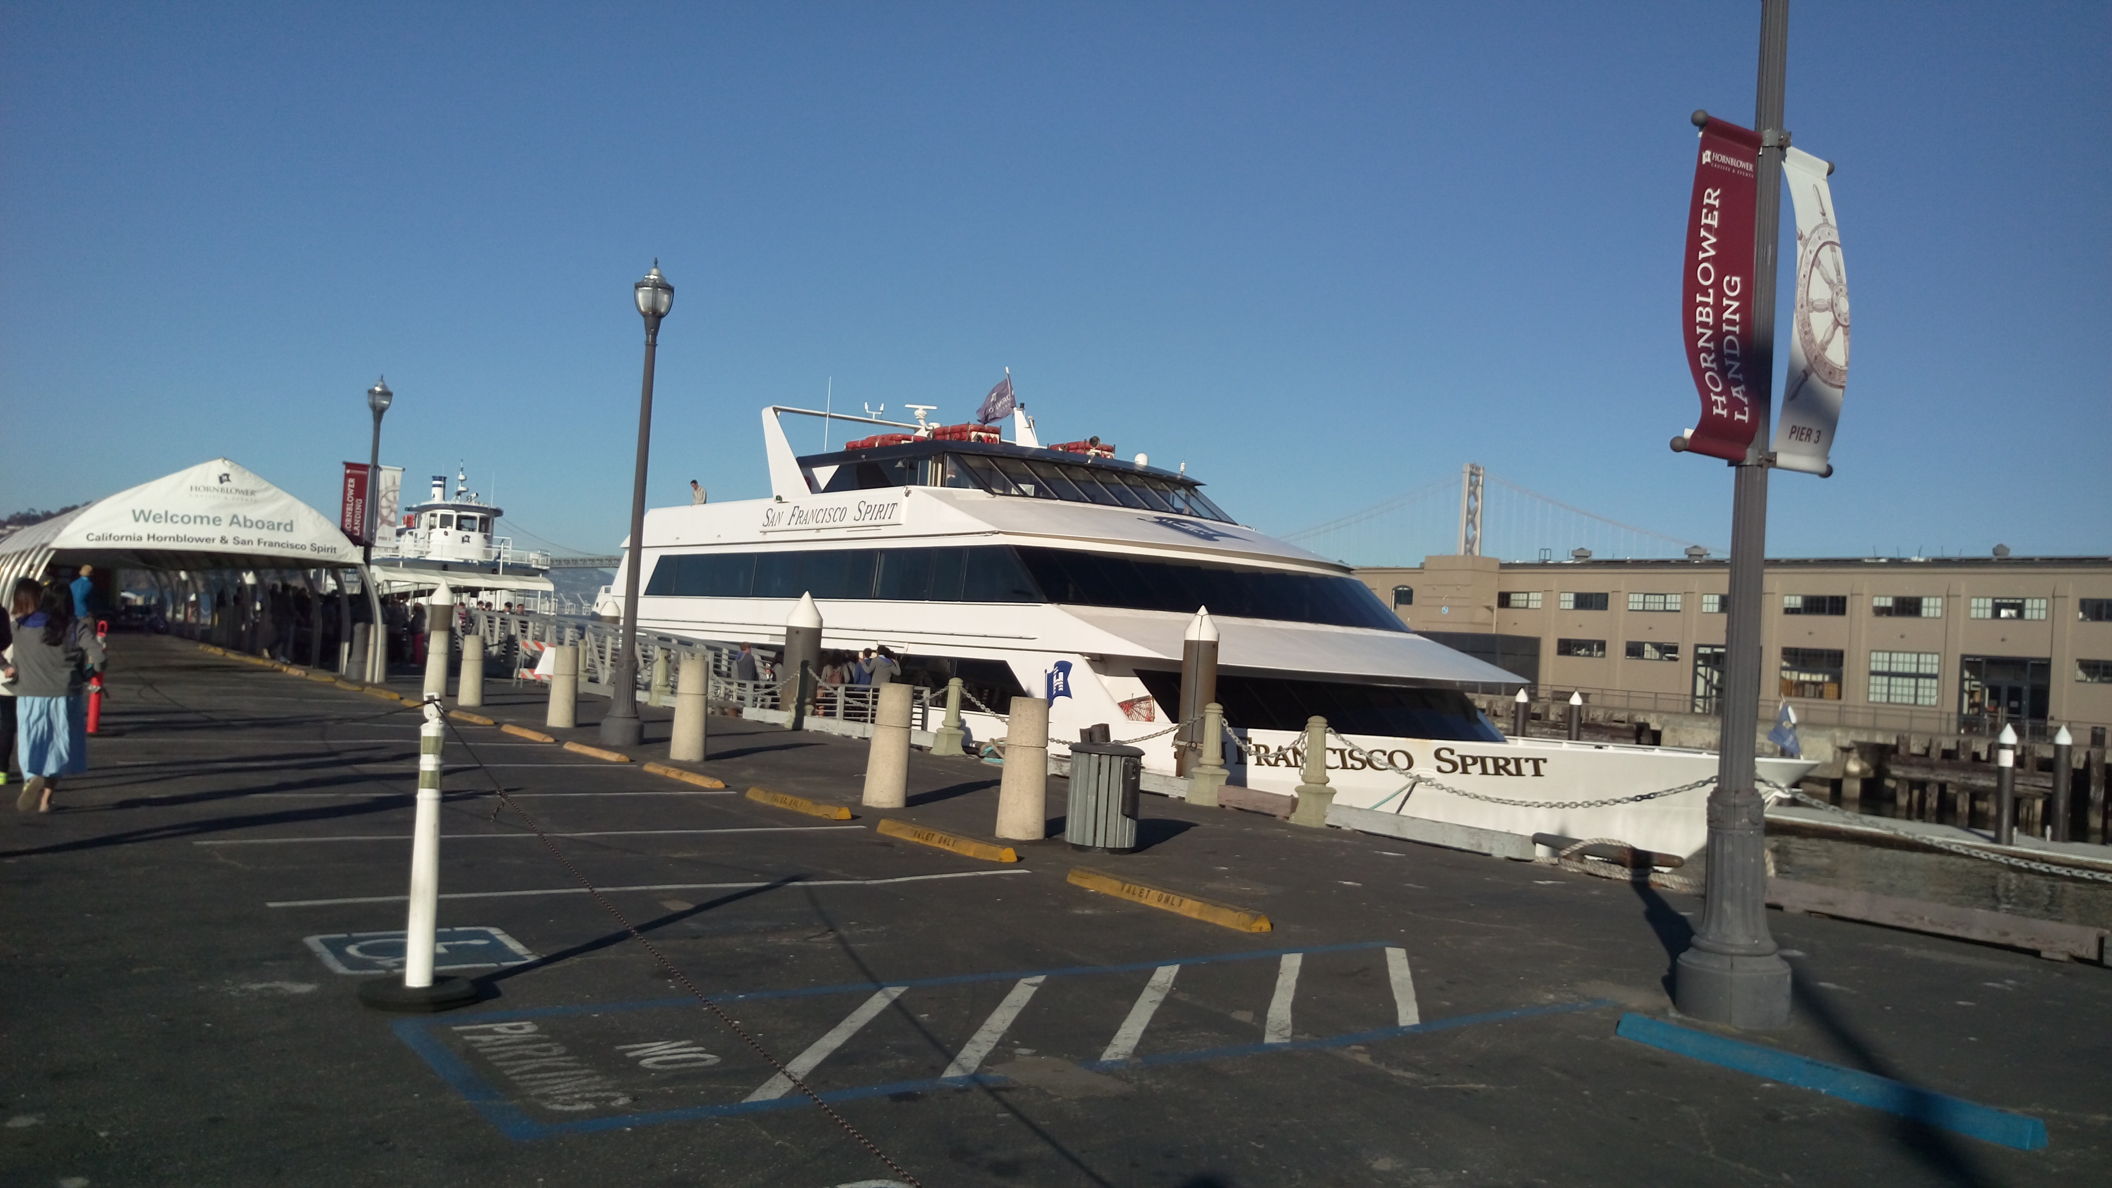
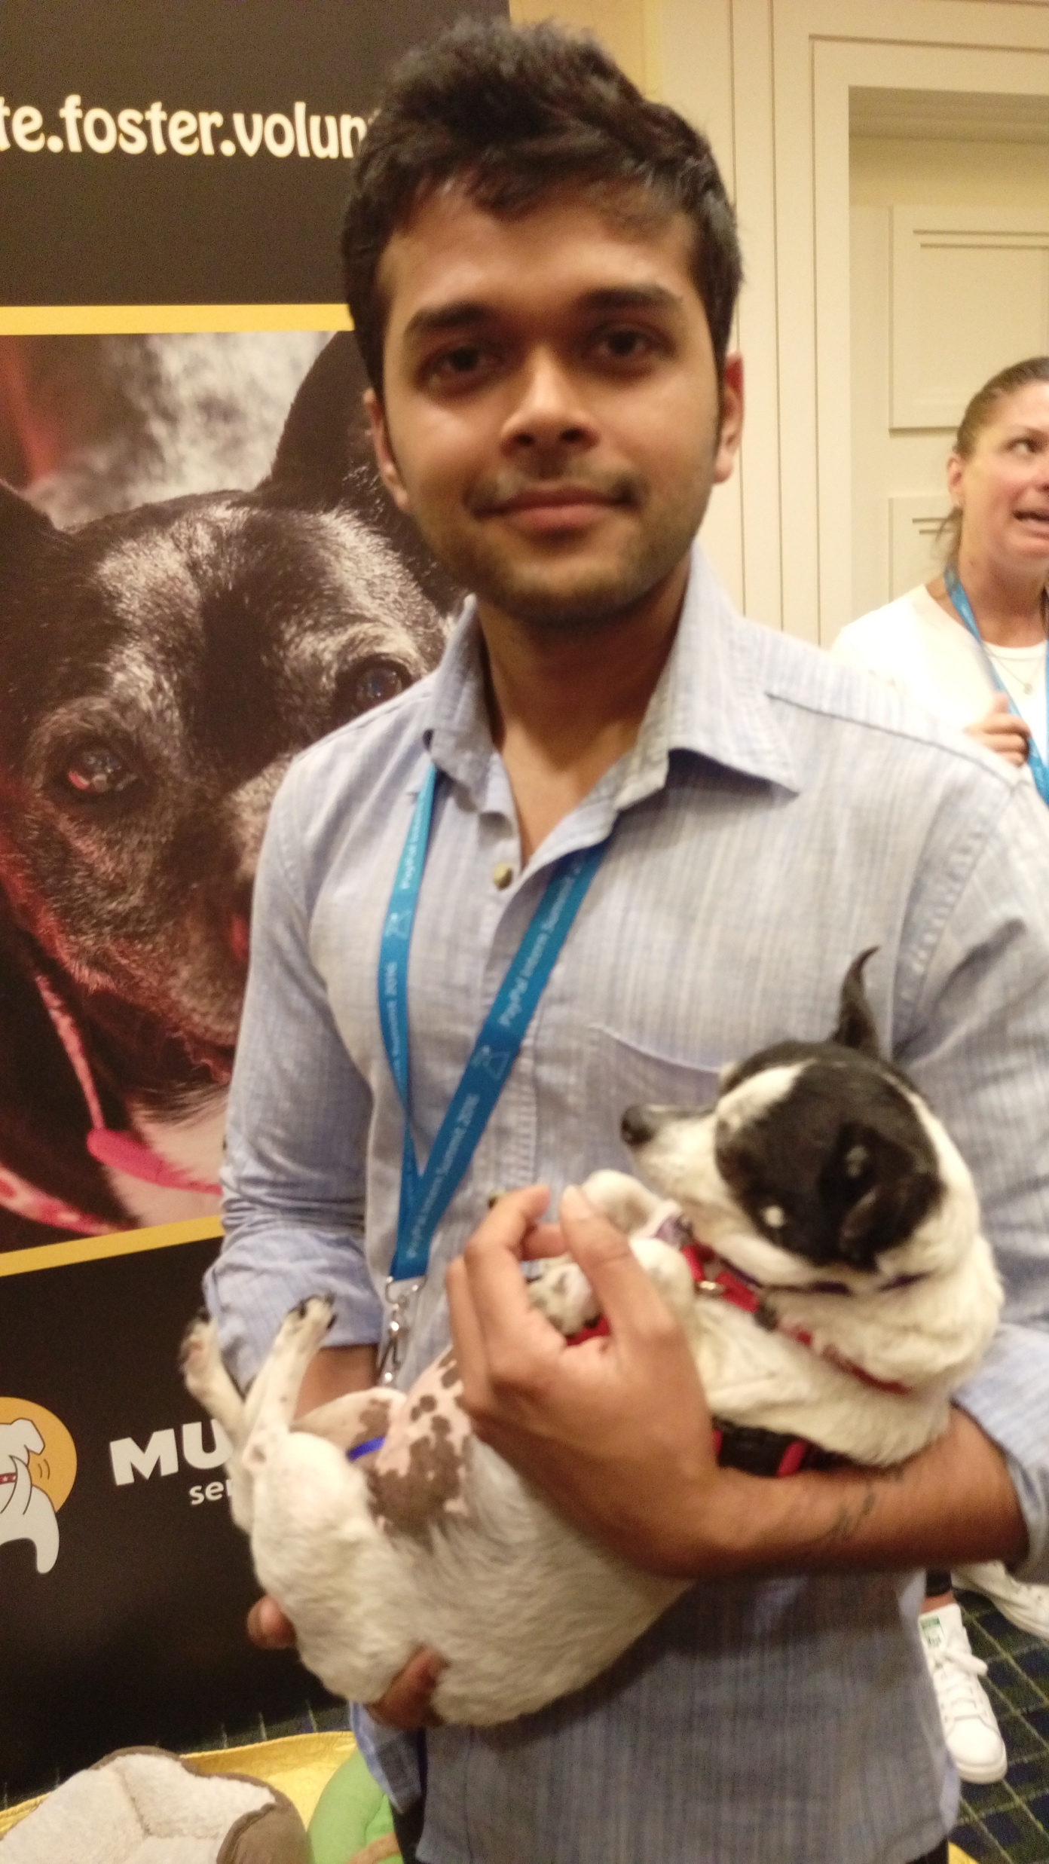

Intern Summit

Slide 24
Lot More Things !
Intern Speed Mentoring
Intern Meetups
Intern Ignite Training
Wine Blending Session
ACM event – Convolution Neural Network for Scoring and Fraud Detection, SF

Slide 25
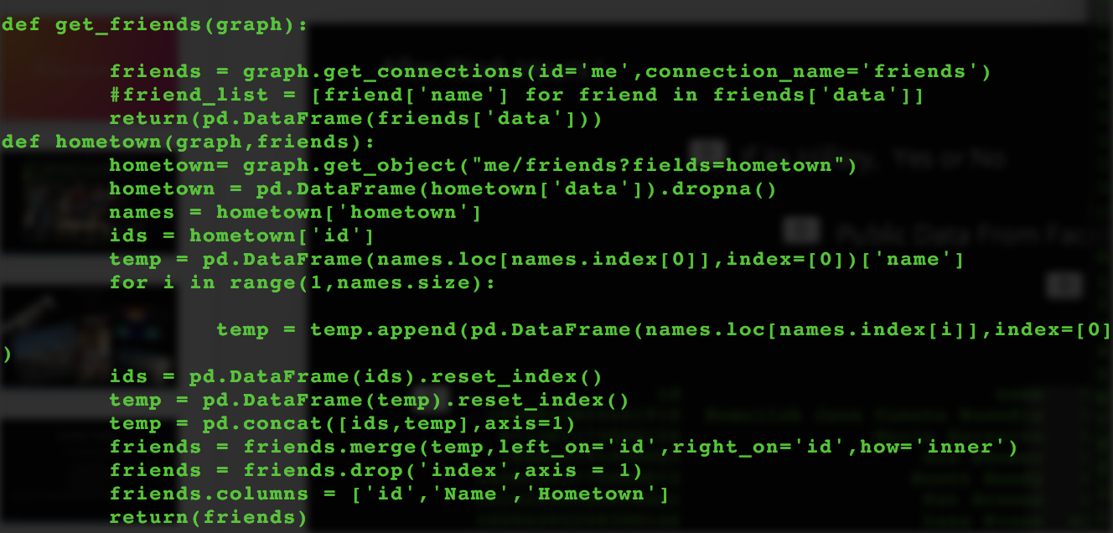
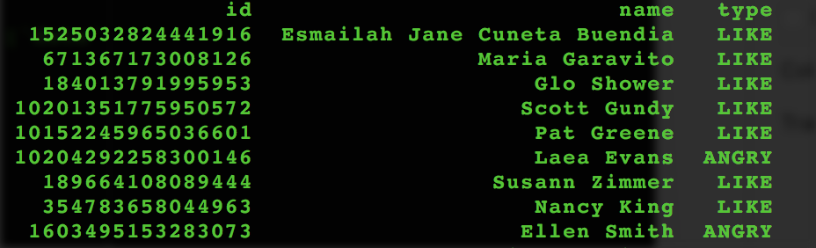
After Work Hours !
If its Hillary, Yes or No
Public Data From Facebook, Twitter,
~52% people Like Hillary
Yet to do More !

Slide 26
Loved being at PayPal

Slide 27
Thankyou, Nachum, Jiri, Xin and University recruitment Team

